Slide 1
Status quo and Prospect for Balanced and Cyclic Utilization Technology of Rare Earth Resources in Rare Earth Permanent Magnet Industry
Comprehensively improving resource utilization efficiency and constructing a resource cyclic utilization system
Speaker: Jingwu Chen
Earth-Panda Advanced Magnetic Material Co., Ltd.
National Key Laboratory of Rare Earth Permanent Magnet Materials
May 12, 2023 Ningbo, Zhejiang

Slide 2
1 Background of balanced and cyclic utilization technology of rare earth resources
2 Status quo of balanced and cyclic utilization technology of rare earth resources
3 Future development of balanced and cyclic utilization technology of rare earth resources
4 Balanced and cyclic utilization of rare earth resources in Earth-Panda
Contents

Slide 3
1
Balanced and cyclic utilization technology of rare earth resources in rare earth permanent
Technology background

Slide 4
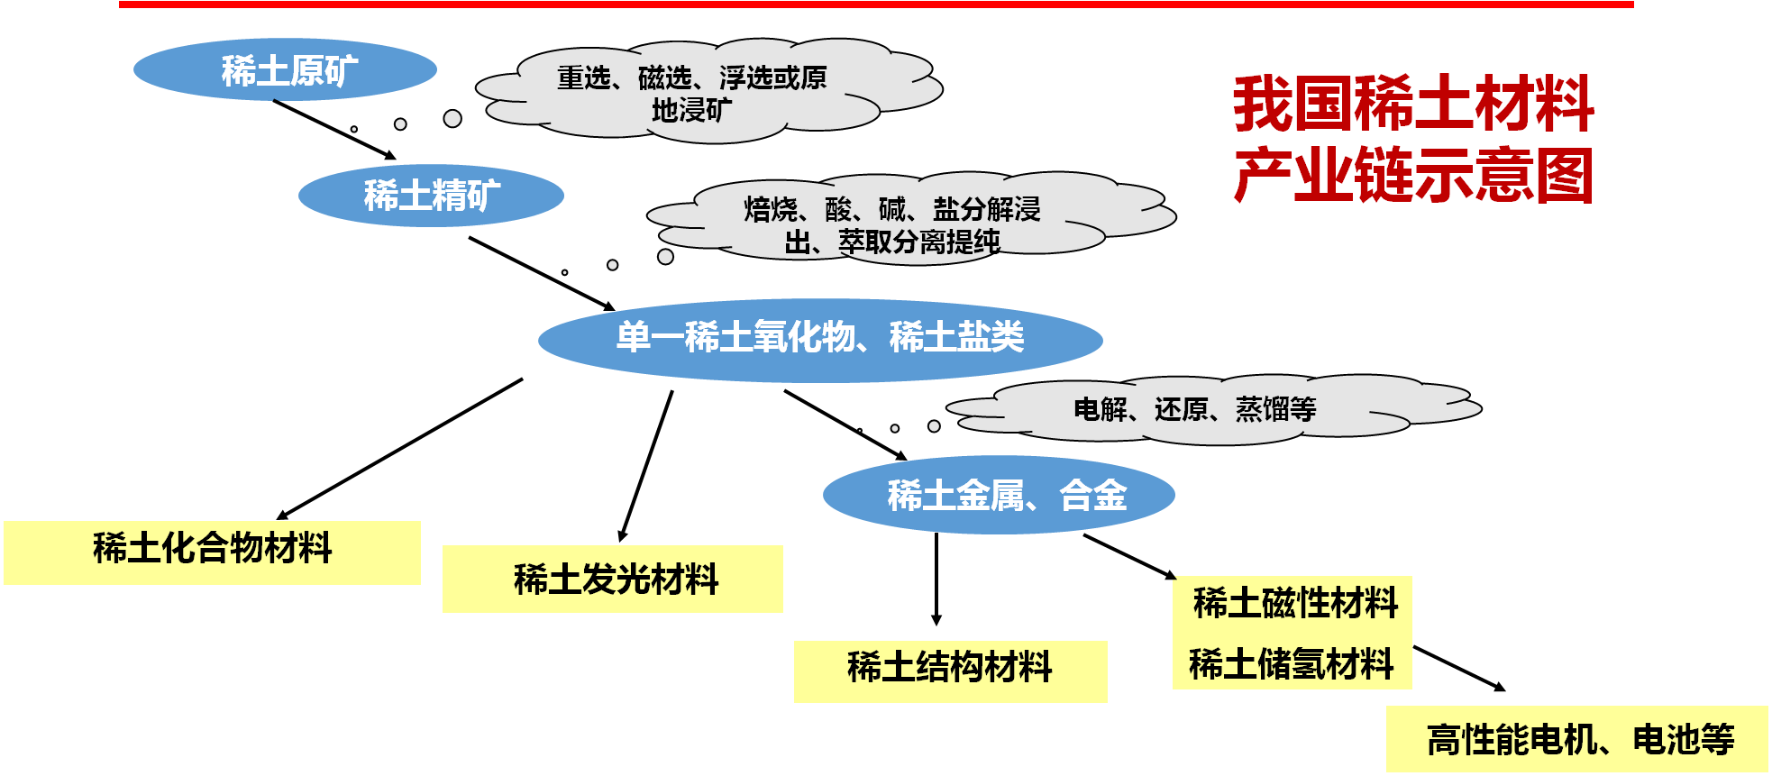

1. Technology background
Rare earth resources could be widely used and the rare earth industry chain includes the mining, beneficiation, smelting, and utilization of rare earth ores.
The rare earth resources are not scarce, and the key lies in how to achieve high-quality and sustainable development of the rare earth new material industry through the high value, balanced and circular utilization of rare earth.
Notes:
在传统材料中适当添加稀土元素，就可以极大的改善和提高其性能，添加了稀土元素的改性材料就称为稀土新材料，包括功能材料和结构材料。

Slide 5
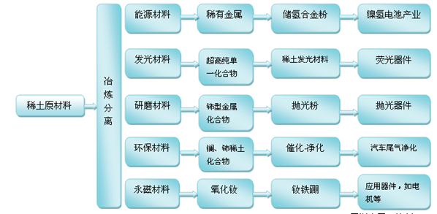
1. Technology background
Materials with the addition of rare earth elements often have properties that traditional materials cannot match, so they are called rare earth new materials, including functional materials and structural materials. Rare earth is also known as industrial "monosodium glutamate" and "vitamin", and could be widely used in various material fields.
Notes:
在传统材料中适当添加稀土元素，就可以极大的改善和提高其性能，添加了稀土元素的改性材料就称为稀土新材料，包括功能材料和结构材料。

Slide 6
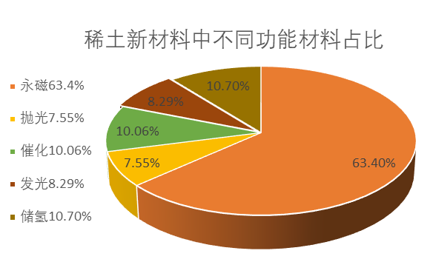
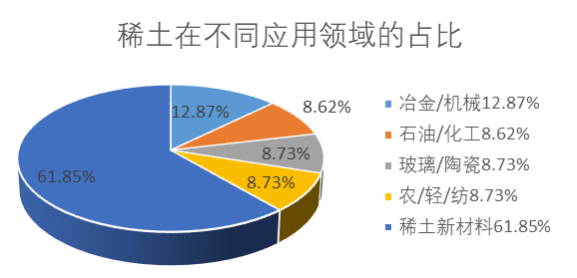
1. Technology background
The rare earth permanent magnet industry is the largest application field of rare earth resources. With the highest magnetic performance and the widest application range in current industrial production, rare earth permanent magnet materials can be used in new energy vehicles, intelligent manufacturing equipment, energy-saving household appliances, wind power generation and other fields and are an important foundation for the survival and development of these fields.
SmCo₅
Sm₂Co₁₇
Nd₂Fe₁₄B
1967 1977 1983
The 1st generation The 2nd generation The 3rd generation

Slide 7
1. Technology background
Unit: 10kt
The output of rare earth permanent magnet materials in China increased from 157,500t in 2017 to 246,000t in 2022, with a compound annual growth rate of 9.35%. The output is expected to continue to grow rapidly in the future, reaching 320,000t by 2025 and over 500,000t by 2030.

Slide 8
1. Technology background
246,000t of rare earth permanent magnet,
220,000t of sintered NdFeB
220,000t of sintered NdFeB, 66,000t of rare
earth metal elements
66,000t of rare earth metal elements,
58,000t of PrNd, 4,000t of LaCe,
4,000t of DyTb

Slide 9
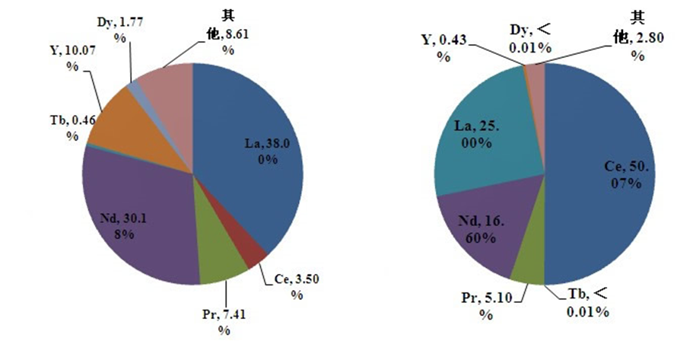
1. Technology background
Rare earth ores in South China
Rare earth ores in North China
 | Reserves | 储量 | Consumption
LaCe | 41.5% | 75.1% | 6.5%
PrNd | 37.6% | 21.7% | 87%
DyTb | 2.23% | ≈0 | 6.5%
There is a serious imbalance between the reserves and using volume of rare earth resources, and balanced utilization is necessary.
LaCe ：41.5%
PrNd ：37.6%
DyTb ：2.23%
LaCe ：75.1%
PrNd ：21.7%
DyTb ：≈0

Slide 10
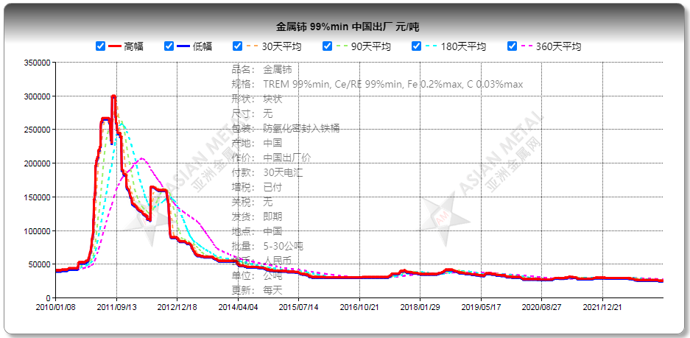
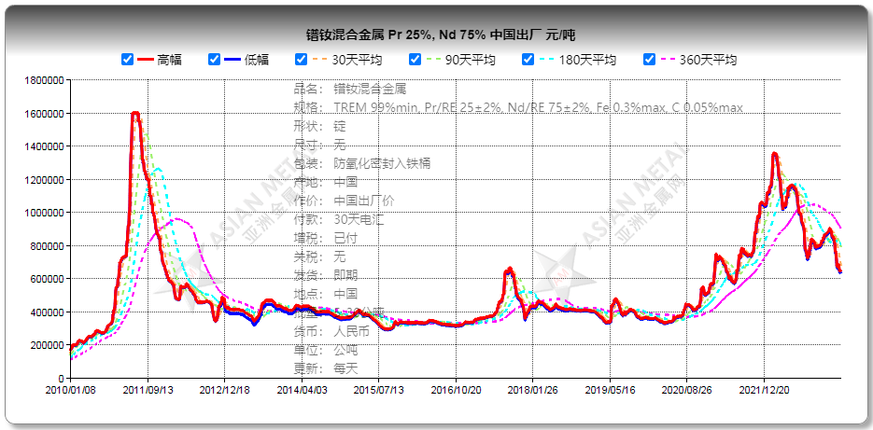
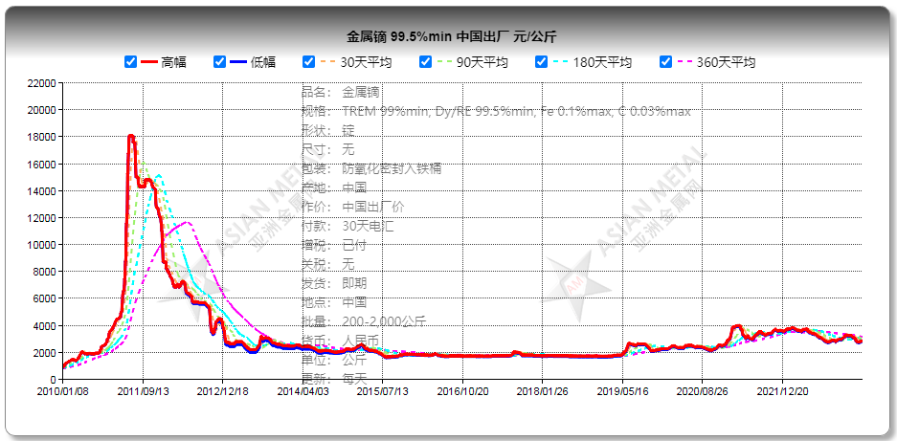
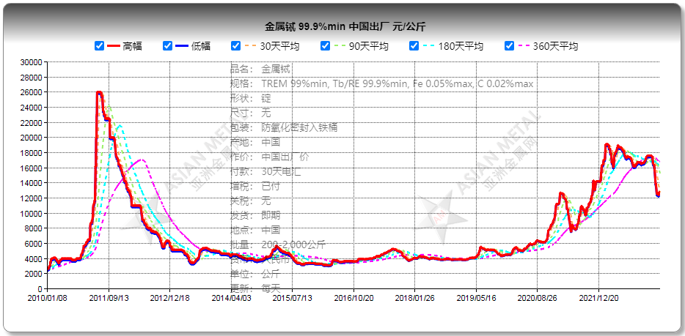
1. Technology background
Ce:RMB25/kg (USD3.62/kg)
PrNd:RMB570/kg (USD82.45/kg)
Through two rounds of fluctuations of rare earth prices, it can be seen that the price of Ce is now stable, and the proportion of Tb/Dy has risen from 2 to nearly 5; the idea of using more Ce, using Dy instead of Tb, and using less Dy/Tb can significantly reduce raw material costs, and has become a direction for industry technology development.
Dy:RMB2,375/kg (USD344/kg)
Tb:RMB11,300/kg (USD1,634/kg)

Slide 11
1. Technology background
Rare earth permanent material (70%)
Material
application
Waste magnet
Rare earth metal
Raw material
Material
manufacturing
Magnet will be discarded as useless
and become obsolete after being
used for 5-10 years.
leftover materials and Scrap (30%)
Calculated based on an annual production of 220,000t of semi-finished materials,
a total of 66,000t of leftover materials/scrap will be produced; calculated based on
an application period of 8 years, 130,000t of waste magnets
will be produced with a total volume of 200,000t,
including 60,000t of rare earth elements.
It’s very necessary to realize circular utilization of waste rare earth permanent magnet materials, which contain large volumes of rare earth.

Slide 12
2
Balanced and cyclic utilization technology of rare earth resources in rare earth permanent magnet industry
Technology status quo

Slide 13
2. Technology status quo—Overview
Balanced utilization: Efficiency improvement technology of heavy rare earth
Improving the utilization efficiency of heavy rare earth resources such as Dy and Tb, and saving heavy rare earth resources;
Balanced utilization: Utilization technology of high abundance rare earth
Improving the main performance of La/Ce-rich magnet and accelerating the use of high abundance rare earth;
Cyclic utilization: Preparation technology of regenerated magnet
Developing efficient recycling and reuse technologies for waste magnet and building a cyclic utilization industry chain.

Slide 14
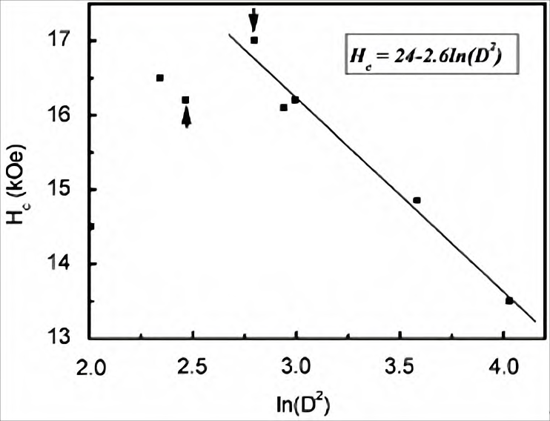
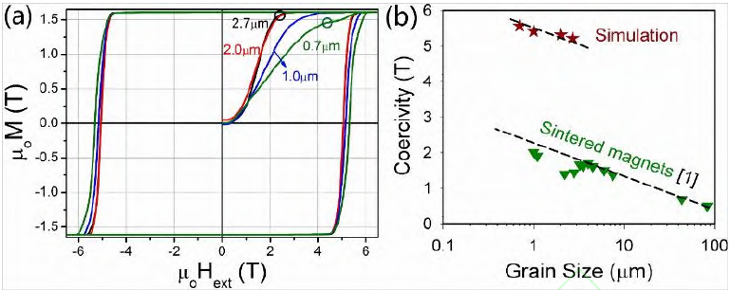
2. Technology status quo—efficiency improvement technology for heavy rare earth
Grain refinement technology
Curve for the relationship between magnet coercivity and grain size
(a) Magnetization curves of simulated magnets with different average grain sizes
(b) Comparison of the relationship between coercivity and grain size of sintered NdFeB magnets reported in micro magnetic simulations and experiments
If the grain size reduces from 10μm to 5μm, the coercivity will increase by about 3kOe, and 1.5wt% of heavy rare earth Dy will be saved.

Slide 15
2. Technology status quo—efficiency improvement technology for heavy rare earth
Grain boundary doping technology: Controlling heavy rare earth elements at grain boundary and the surface layer of the main phase grain.
富重稀土粉末
（合金粉）
NdFeB alloy powder
Mixed powder
Final magnet

Slide 16
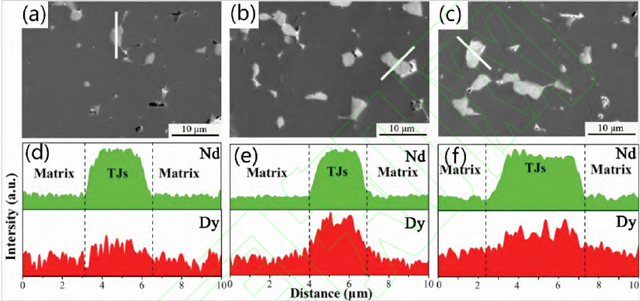
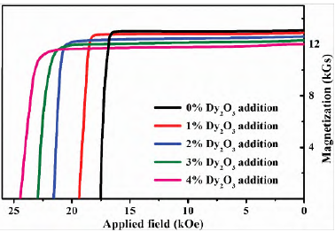
2. Technology status quo—efficiency improvement technology for heavy rare earth
Grain boundary doping technology: Controlling heavy rare earth element at grain boundary and the surface layer of the main phase grain.
Demagnetization curves of magnets with the addition of different amounts of Dy2O3
Backscatter scanning electron microscopy images and elemental distribution graphs of magnets with Dy2O3 mass fractions of 0% (a, d), 2% (b, e) and 4% (c, f) respectively
The coercivity will increase by 2kOe if 1wt% of Dy is added and about 3kOe if the grain boundary is doped with 1wt% of Dy. Heavy rare earth demand will decline by one third in order to achieve the same increase of coercivity.

Slide 17
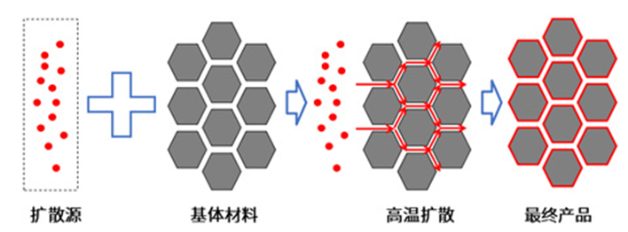
2. Technology status quo—efficiency improvement technology for heavy rare earth
Grain boundary diffusion technology: Controlling heavy rare earth element at grain boundary and the surface layer of the main phase grain.
Diffusion source
Matrix material
High-temperature
diffusion
Final product
The coercivity will increase by 2kOe if 1wt% of Dy is added; the coercivity will increase by about 6kOe if the grain boundary diffuses by 0.5wt% of Dy. Heavy rare earth demand will decline by five sixth in order to achieve the same increase of coercivity.

Slide 18
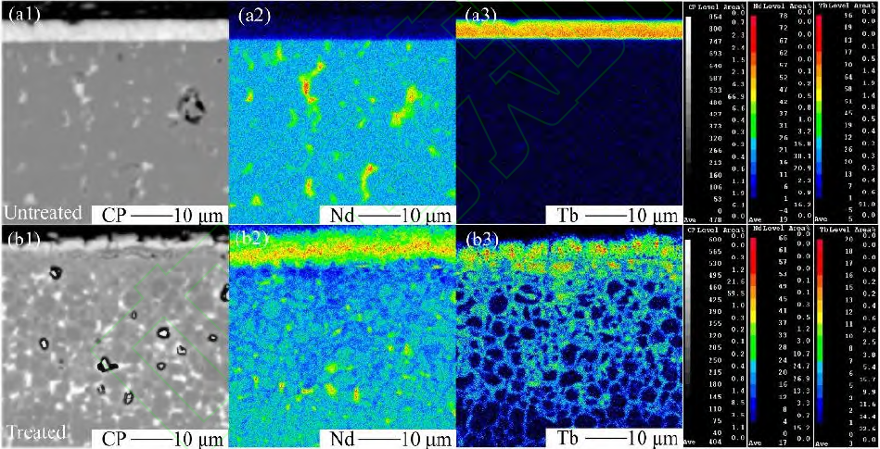
2. Technology status quo—efficiency improvement technology for heavy rare earth
Grain boundary diffusion technology: Controlling heavy rare earth element at grain boundary and the surface layer of the main phase grain.
Adhesion mode of diffusion sources and substrates: coating, spraying, magneto-controlled sputter coating, screen printing, etc.
Diffusion sources: Dy and Tb metals; Dy and Tb compounds; Dy and Tb alloys.
EPMA images of Nd and Tb elements in magneto-controlled sputter deposition Tb magnet: (a) is before diffusion and (b) is after diffusion

Slide 19
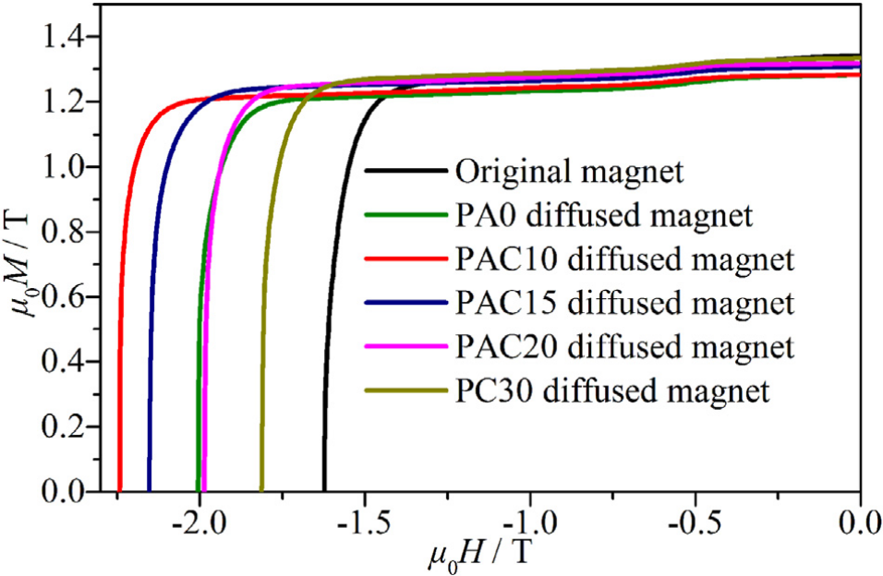
2. Technology status quo—efficiency improvement technology for heavy rare earth
Grain boundary diffusion technology: Low melting point of light rare earth alloys are used as diffusion sources, without the use of heavy rare earth elements.
The increase in coercivity of magnets after diffusion of light rare earth alloys with different compositions
Diffusion source composition | Diffusion source morphology | Thickness of magnet (mm) | ΔH_{cj} (kOe)
Nd₇₀Cu₃₀ | Alloy slice | 4 | 6.1
Pr₆₈Cu₃₂ | Melt-spun ribbon | 5 | 6.6
Pr₇₀Al₂₀Cu₁₀ | Melt-spun ribbon | 2 | 8.9
Pr₇₀Al₂₀Cu₁₀ | Melt-spun ribbon | 10 | 6.1
Pr₇₀Al₂₀Co₁₀ | Alloy slice | 5 | 6.2
Pr₇₀Al₁₅Co₁₅ | Alloy slice | 5 | 5.3
Pr₇₀Al₃₀ | Alloy slice | 5 | 3.9
Demagnetization curves of Pr70Al30, Pr70Al20 Co10, Pr70Al15 Co15, Pr70Al10 Co20, and Pr70Co30 alloy magnets after diffusion
Diffusion sources: Alloys composed of Pr/Nd and Cu, Ga, Fe, Co, Al elements and others.
The coercivity will increase by 3-8kOe by using low melting point of light rare earth alloys as diffusion sources.

Slide 20
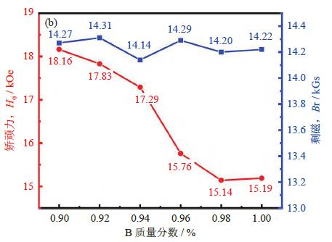
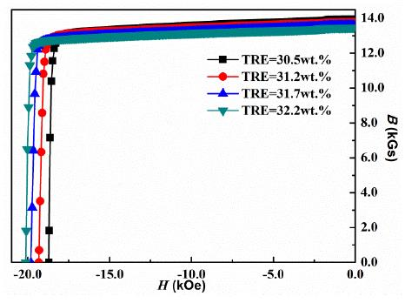
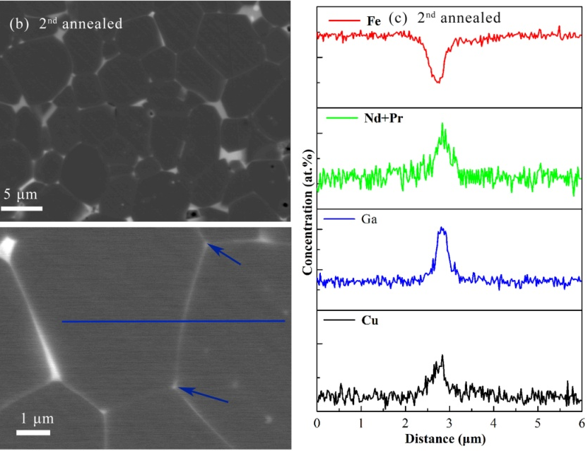
2. Technology status quo—efficiency improvement technology for heavy rare earth
High-Ga low-B technology: High coercivity is achieved through microstructure adjustment and control without the use of heavy rare earth elements.
Curve of coercivity and remanence with different B content
Demagnetization curve of high-Ga low-B series magnet with different rare earth content
Microstructure of high-Ga low-B series magnet
The coercivity of 17-20 kOe could be achieved by the high-Ga low-B technology, which can also remove heavy rare earth elements in products such as 50SH and 52H.
The grain boundary optimization effect of high-Ga low-B system can also be extended to products containing heavy rare earth to reduce the using volume of heavy rare earth by 1wt.% Dy or 0.5wt.%Tb.

Slide 21
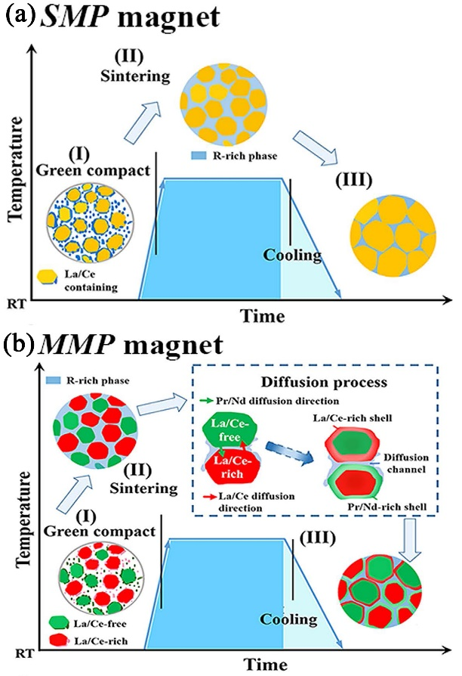
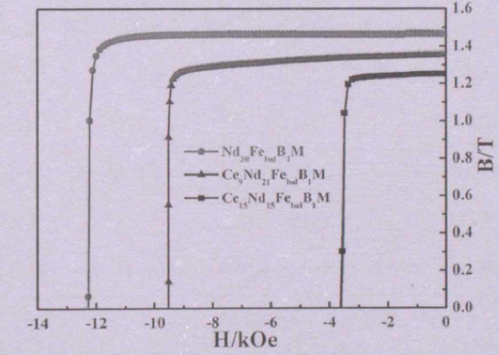
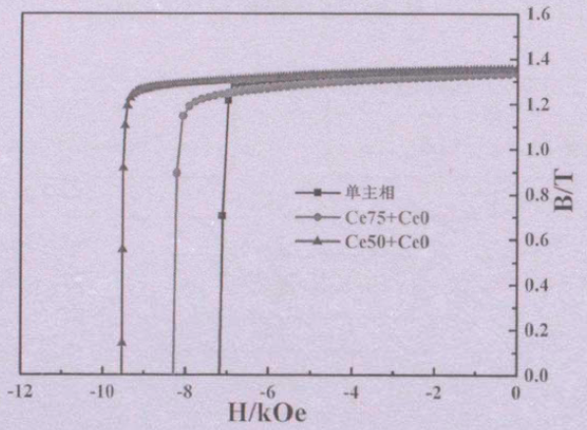
2. Technology status quo-—preparation technology of high abundance rare earth magnets
Cerium magnet - dual main phase technology
Demagnetization curves of magnets with different Ce contents
Demagnetization curves of Ce containing magnets by different processes
Preparation processes of single and double alloys
Replacing PrNd with some Ce can reduce the performance of the magnet, but using a dual main phase process can improve the magnetic properties of the magnet.
The dual main phase process has achieved the preparation of high-performance cerium magnet.

Slide 22
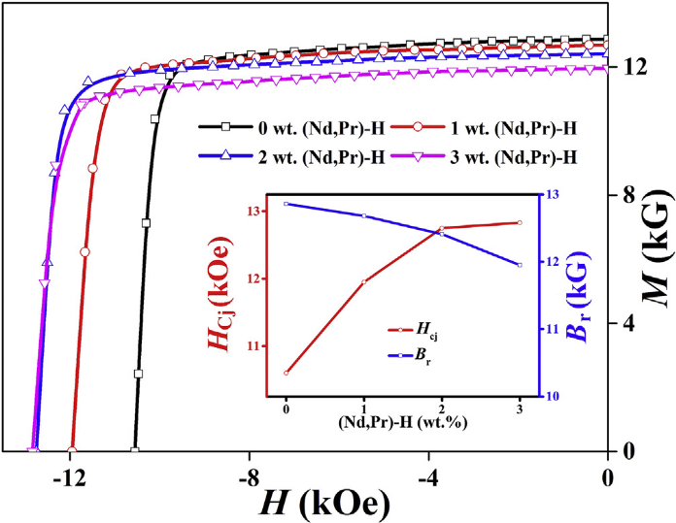
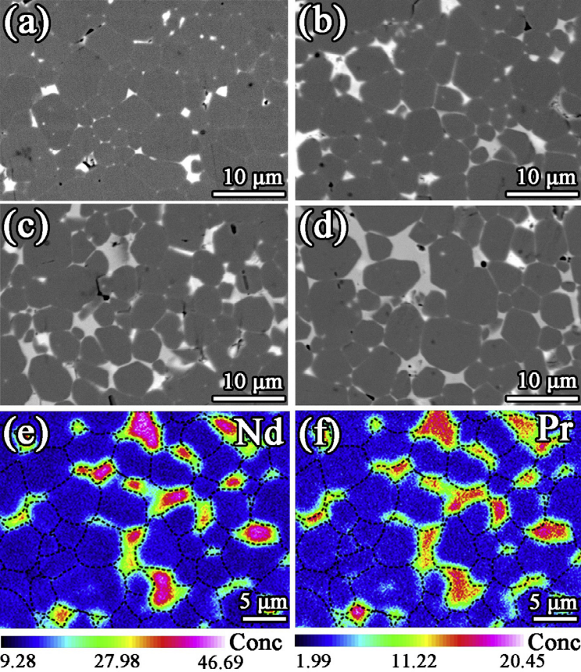
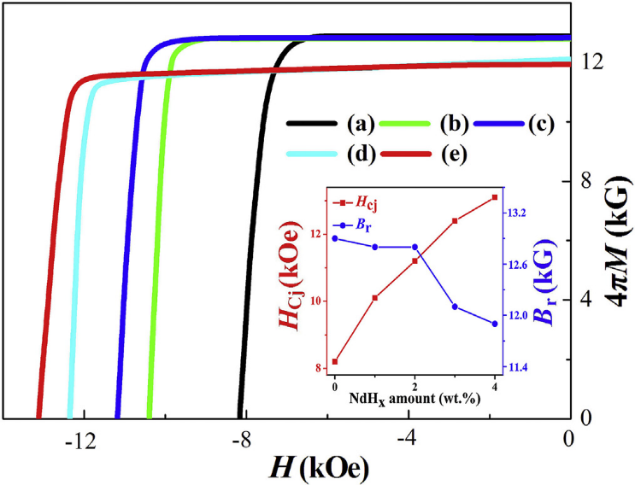
2. Technology status quo-—preparation technology of high abundance rare earth magnets
Cerium magnet - grain boundary reconstruction technology
Magnetic properties and microstructure of Ce-27 magnets with the addition of (Nd80Pr20) Hx single alloy
Magnetic Properties of Ce-27 Magnets with the addition of (Nd80Pr20) Hx dual alloy
Rare earth hydrides or low melting point rare earth alloys can be added to single alloy Ce magnet or dual alloy Ce magnet for grain boundary reconstruction, to promote the formation of continuous and thick grain boundary phases between grains to improve coercivity.

Slide 23
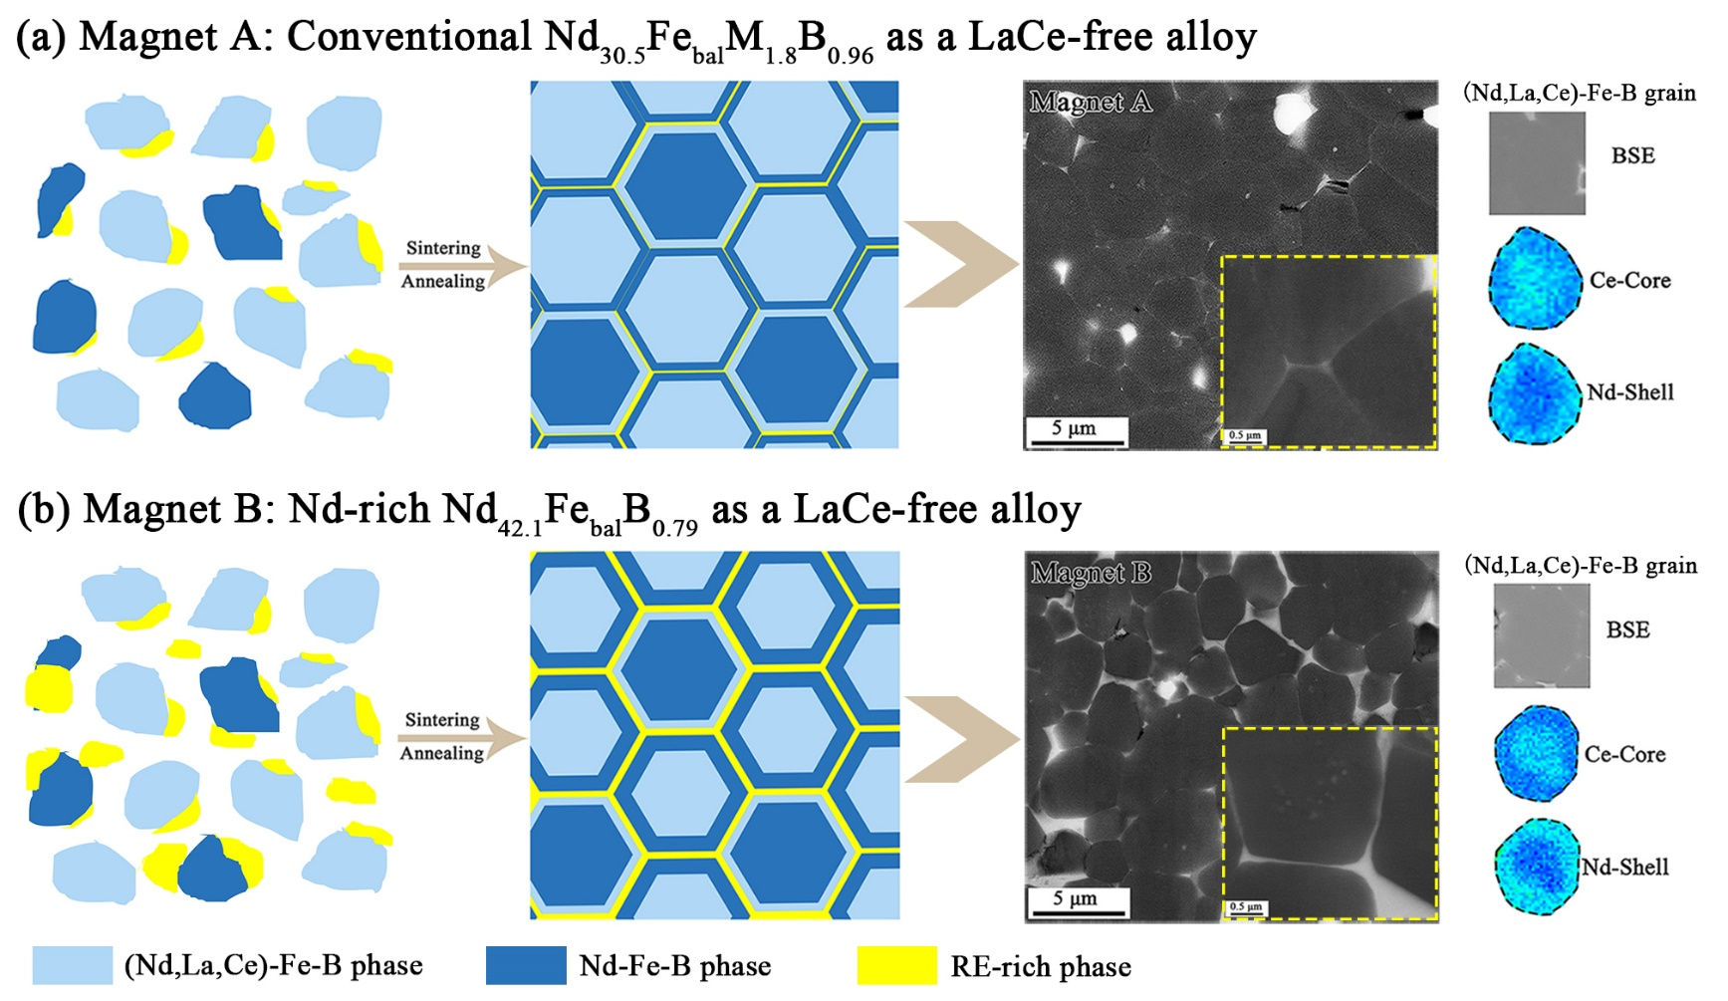
2. Technology status quo-—preparation technology of high abundance rare earth magnets
Cerium magnet - Synergistic effect of dual main phase and grain boundary reconstruction
New dual main phase process – using LaCe-rich alloy and Nd-rich LaCe-free alloy as the two main phases;
Advantages: The Nd-rich LaCe-free alloy can provide the main phase and sufficient Nd-rich phase - forming a continuous thick grain boundary phase layer; the surface layer of LaCe-rich grain forms a thick Nd-rich shell layer with higher Nd concentration.
The coercivity increases by 30%~50% compared to that of ordinary dual main phase magnet.
Comparison of microstructure of dual alloy Ce magnets prepared using traditional Nd Fe-B alloy and Nd-rich Nd Fe-B alloy

Slide 24
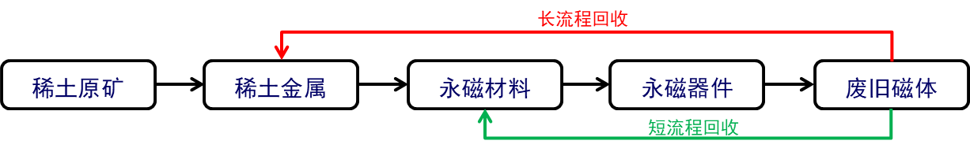
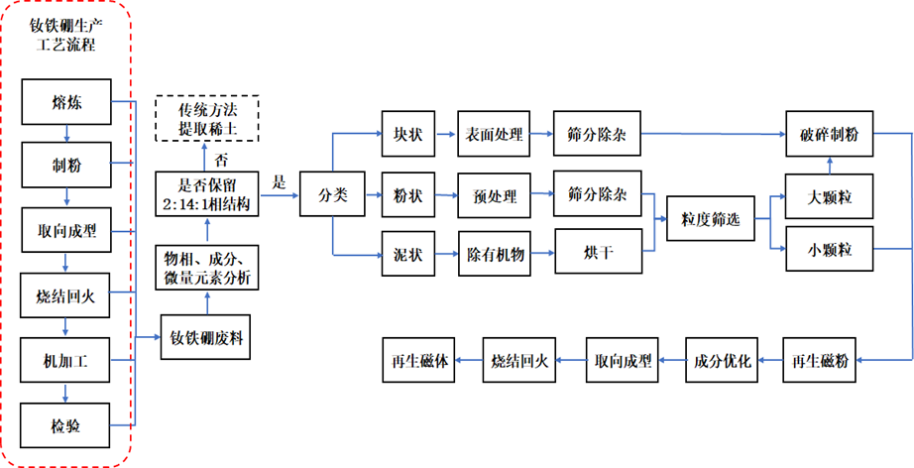
2. Technology status quo—preparation technology of high performance regenerated magnet
Long process recycling: breaking the original 2:14:1 phase structure and recycling in the form of a single element;
Short process recycling: recycling 2:14:1 phase overall.

Slide 25
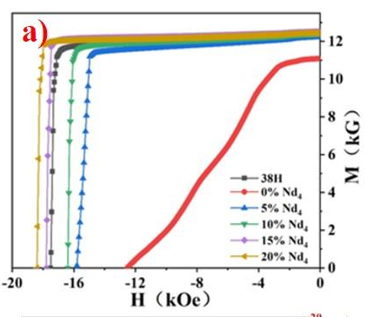
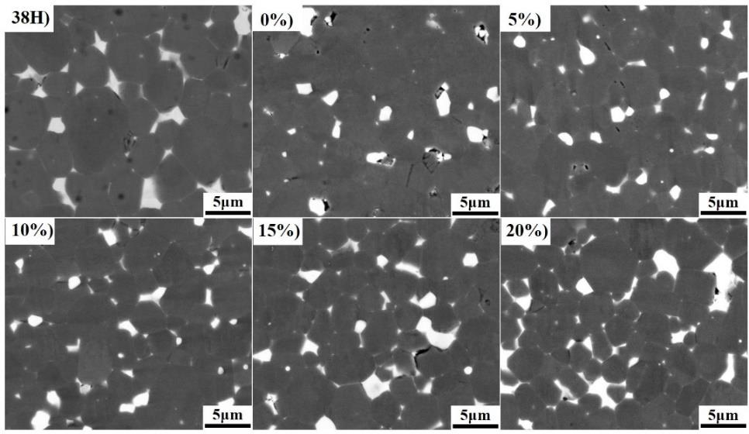
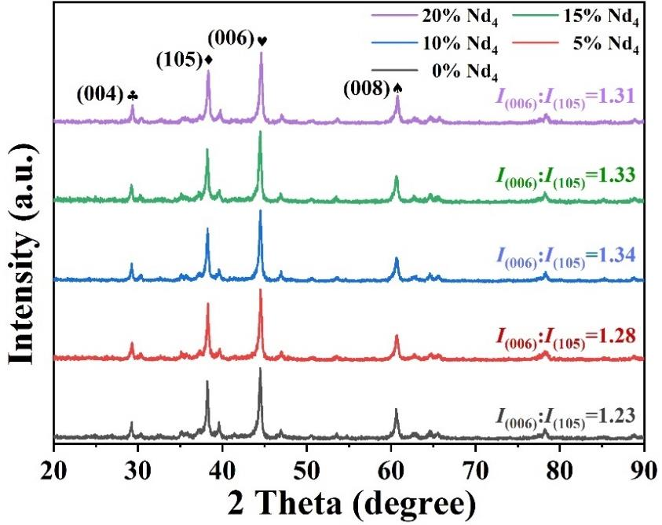
2. Technology status quo—preparation technology of high performance regenerated magnet
Production technology of high coercivity regenerated magnet based on NdFeB scrap materials
Electron microscopic photos of regenerated magnets with different addition volume of rich in rare earth alloys
Magnetic properties of regenerated magnets sintered with rich in rare earth alloys
XRD testing of regenerated magnets with different addition amount of rich in rare earth alloys
As the addition amount increases, the performance of the magnet continues to improve; when the addition amount is 15wt.%, the Br (remanence) will be 12.50kGs, the coercivity Hcj will be 17.79kOe, and the (BH)max will be 35.25MGOe, all exceeding the performance of the original 38H magnet.
Regenerated magnets without adding rich in rare earth alloys have poor grain boundary phases, with neodymium-rich phases enriched in large blocks at triangular grain boundaries and severe adhesion between the main phase grains; as the addition amount increases, the small particle rich in rare earth phase increases. On the one hand, it causes a sharp decrease in the large block neodymium-rich phase, and on the other hand, it separates the waste grains, enhancing the flow of the neodymium-rich phase and helping enhance the coercivity of the magnets. However, many small particles can cause the decrease in the remanence of magnets. As the addition amount increases, the value of I (006)/I (105) will increase firstly and then decrease.

Slide 26
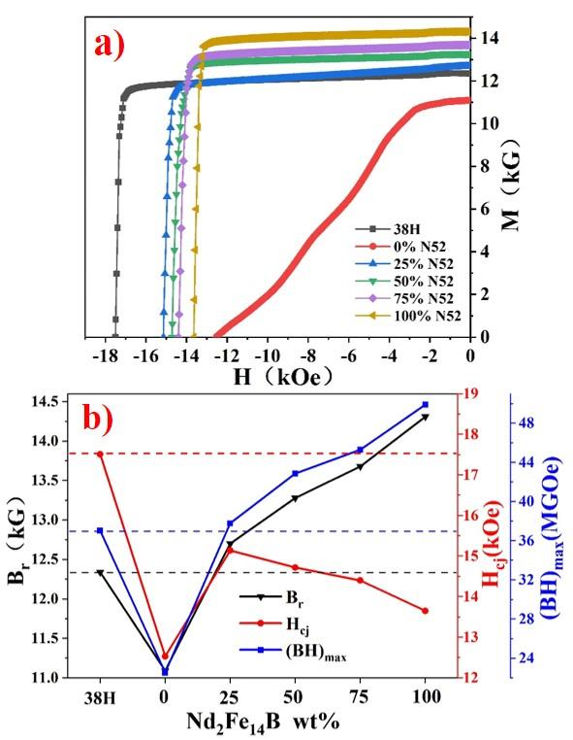
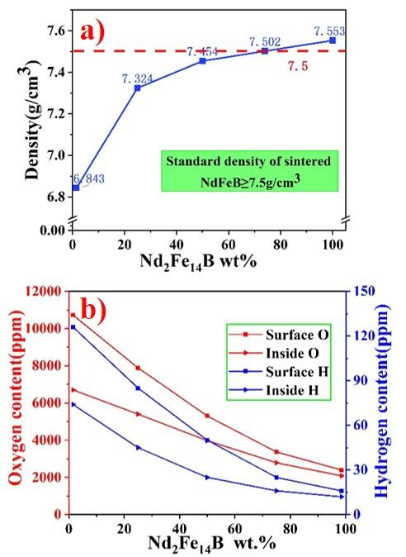
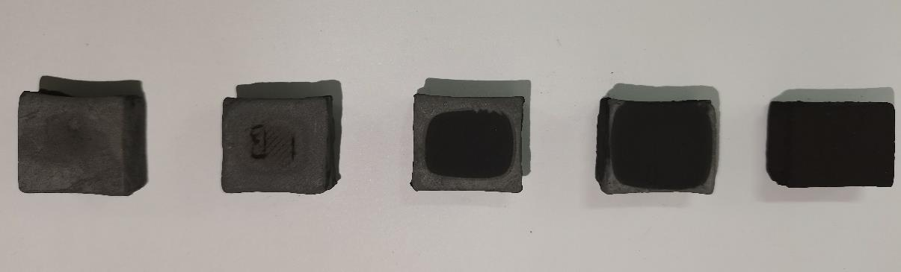
2. Technology status quo—preparation technology of high performance regenerated magnet
Preparation technology of high remanence regenerated magnets based on NdFeB scrap materials
Surface morphology of regenerated magnets sintered with N52 alloy powder
As the addition amount increases, the magnetic properties will reach 38M, 42M, and 45M levels respectively.
When the addition amount of N52 alloy is 75wt.%, the oxygen content in the surface and core of the magnets will decrease to around 3000ppm, the hydrogen content will decrease to around 20ppm and the difference between the surface and core will decrease, resulting in a significant improvement in the shrinkage uniformity of the regenerated magnets.
Performance of regenerated magnets sintered with N52 alloy: a) is for magnetic properties and b) is for the comparison of magnetic properties
Density and H, O contents of regenerated magnets: a) is for regenerated magnet density and b) is for H and O contents of regenerated magnets

Slide 27
2. Technology status quo—preparation technology of high performance regenerated magnet
Carbon footprint corresponding to raw materials
No.1 | Name | Carbon footprint t(kgCO2e)
1 | Iron ore mining | 16.3557
2 | Beneficiation | 0.4705
3 | Extraction | 11.6827
4 | Extraction and separation | 4.2218
5 | Screening | 0.5175
6 | Drying | 1.1711
7 | Waste water treatment | 4.069
8 | Electrolysis | 8.3876
9 | Smelting (SC Alloy) | 3.2372
10 | Total | 50.1131
Carbon footprint corresponding to production process
Name | Material production | Surface Treatment | Permeation | Packaging | Mechanical processing | Total
Carbon footprint （kgCO2e） | 14.9 | 6.764 | 1.042 | 0.474 | 0.475 | 23.653
Carbon comparison of products from different processes
Recycling and reusing waste magnets can significantly reduce carbon emissions during the production process of magnets. The carbon emission will be cut by 22.81% for regenerated magnets by long process and 33.97% with the addition proportion of 50% through short process and even reach 65% as the addition proportion increases to 90%.
Process | Carbon footprint（kgCO2e）
 | Raw material | productive process | Total emission
Conventional process | 50.1131 | 23.653 | 73.77
Short process | 33.2869 | 23.653 | 56.94
Short process | 50.1131*(1-X) | 23.653 | 48.71 （X=0.5）
Short process | 50.1131*(1-X) | 23.653 | 26.30 （X=0.9）
The addition ratio of X short process regeneration is (0 ≤ X ≤ 1)

Slide 28
3
Balanced and cyclic utilization technology of rare earth resources in rare earth permanent magnet industry
Future development

Slide 29
3. Future development
  3.1 Efficiency improvement of heavy rare earth element
  Multi-element co-diffusion, reduction of heavy rare earth proportion and improvement of diffusion efficiency (Tb Al, Tb Cu, Pr Tb Cu Al);
  Optimization of diffusion process, step-by-step diffusion (grain boundary diffusion+intra grain diffusion), reduction of heavy rare earth consumption (1% → 0.6% → 0.3% →....)
  Based on high performance and the cost reduction of high-performance products
  3.2 Property improvement for high abundance rare earth permanent magnet
  Cerium magnet grain boundary diffusion, mixed rare earth permanent magnets, raising addition ratio of medium to low performance products, and expanding application fields of motors
  Based on comprehensive utilization of resources and cost reduction of medium to low performance products
  3.3 Recycling and reuse of waste magnets
  Classification and recycling (block → powder → oil sludge), expanding the production of short process regenerated magnets based on the long-term recycling of rare earth metals
  In order to reduce carbon emissions and resource consumption, Apple has committed to using 100% recycled rare earth as raw materials or directly regenerated rare earth permanent magnets by 2025, making full play of "urban mine“.
We shall comprehensively improve the efficiency of rare earth resource utilization, build a rare earth resource recycling system in order to achieve green and sustainable development of the rare earth permanent magnet industry.

Slide 30
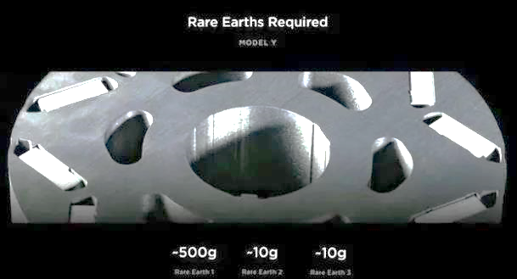
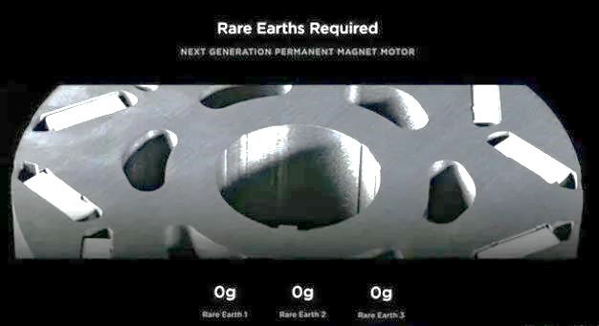
3. Future development
3.4 Future development direction of automotive motors——reducing the using amount of rare earth??
The current motors used by Tesla use 500g, 10g, and 10g of rare earth elements praseodymium neodymium, dysprosium and terbium respectively.
Tesla's next generation motors are expected to reduce the using amount of all the above-mentioned three rare earth elements to 0g.

Slide 31
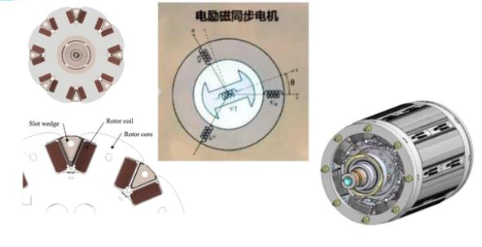
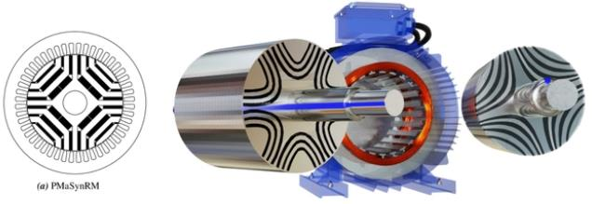
3. Future development
3.4.1 Possible development direction of rare earth free automotive motors—motor structure adjustment
1 Electric excitation motor
2 Reluctance synchronous motor
Add an excitation coil to the motor winding and adjust the motor speed by adjusting the current inside the excitation coil.
Reluctance synchronous technology combines the performance of permanent magnet motors with the simplicity and easy-to-use of induction motors.
The 5th generation BMW eDrive electric drive system independently developed by BMW Group is already a mass-produced rare earth free application.
Nissan ARIYA also uses electric excitation motors.
The use of this type of motor is still in its early stages and it can be used
without rare earths.
The use of electric excitation motors can achieve rare earth removal, but it still couldn't meet some requirements (such as energy efficiency and noise).

Slide 32
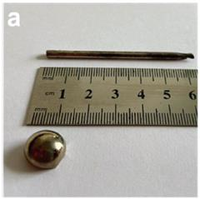
3. Future development
3.4.2 Possible development direction of rare earth free automotive motors —developing new non rare earth permanent magnets
Non rare earth permanent magnet material systems: Mn-based alloys (MnBi and MnAl), AlNiCo, L10-FeNi/FeCo, Fe16N2, etc.
MnAl, MnBi - room temperature performance range Hci~6.5 kOe, (BH) max~8.7 MGOe; the preparation conditions are harsh.
L10-FeNi - found in meteorites, with an estimated maximum (BH)max of 56 MGOe at room temperature; with difficulty in synthesis.
In 2022, the Cambridge University team synthesized FeNi alloy for the first time through direct casting with the addition of P element. Unfortunately, no magnetic properties have been reported!
Fe16N2 - high saturation magnetization (2.9 T) and high magnetic anisotropy constant (1.8 MJ/m3); It is difficult to synthesize and prone to phase decomposition.
Photo of FeNi alloy prepared
At present, new synthesis methods include ion implantation, stress-strain and low-temperature nitriding, but the manufacturing of large magnets is still difficult.
The industrialization of non rare earth permanent magnets is facing numerous difficulties, and the various advantages of rare earth permanent magnets determine that they are still the primary choice for high-performance permanent magnet synchronous drive motors!

Slide 33
4
Balanced and cyclic utilization technology of rare earth resources in rare earth permanent magnet industry
Balanced and cyclic utilization of rare earth resources in Earth-Panda

Slide 34
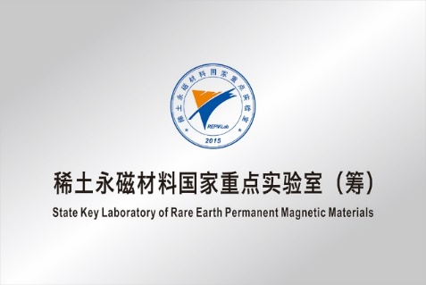
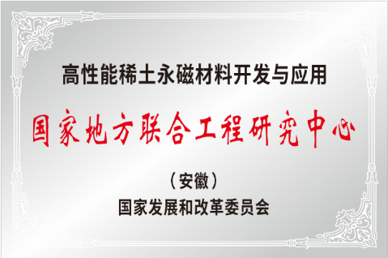

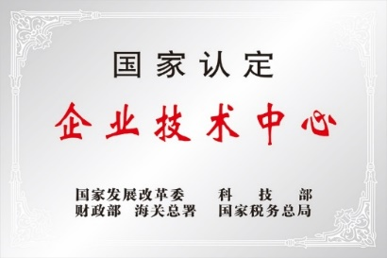
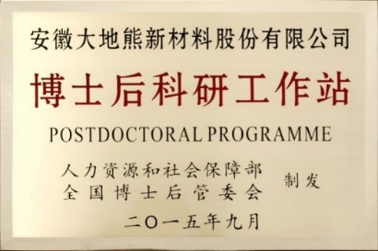
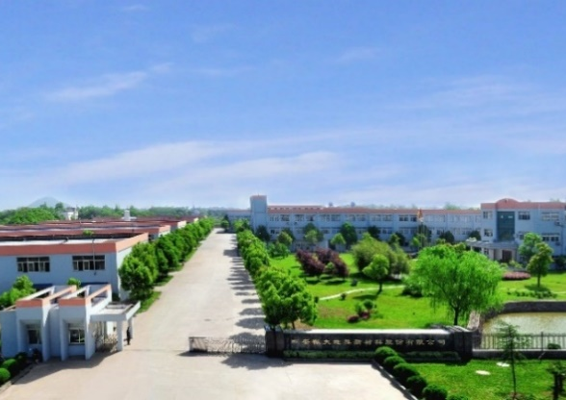
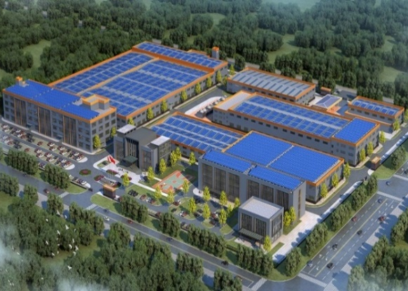
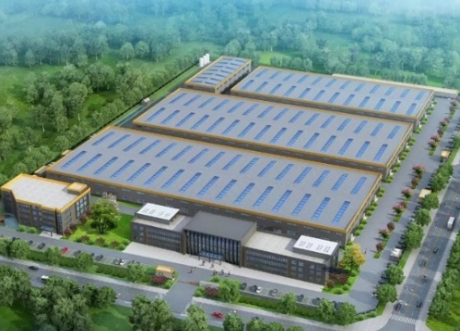
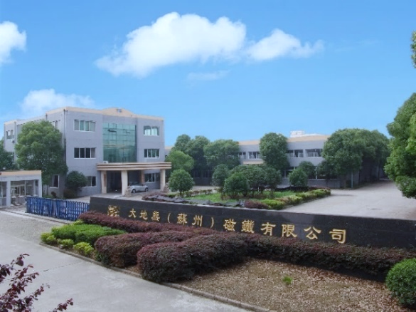
4. Balanced and cyclic utilization of rare earth resources in Earth-Panda
  (1) Earth-Panda Advanced Magnetic Material Co., Ltd.
The company was established in 2003 and was listed on the STAR Market in 2020 (securities code "688077").
It has four production bases and four national R&D platforms.
It focuses on the R&D, production, and operation of rare earth permanent magnet materials.
It is a national high-tech enterprise.
It is a national innovative pilot enterprise.
It owns a well-known Chinese trademark.
It has passed ISO 9001, ISO 14001, IATF 16949, ISO50001, ISO17025, and TISAX system certifications.
Lujiang in Anhui
Baotou in Inner Mongolia
Ningguo in Anhui
Suzhou in Jiangsu

Slide 35
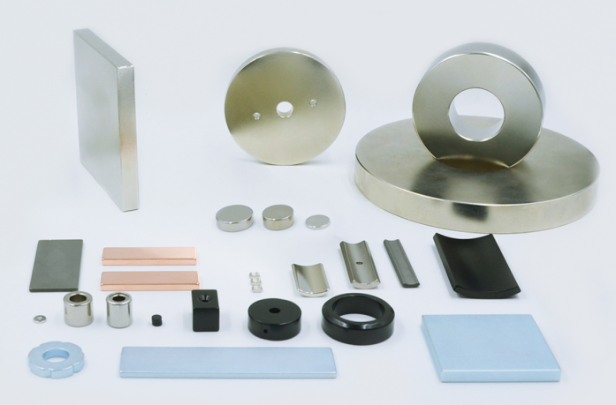
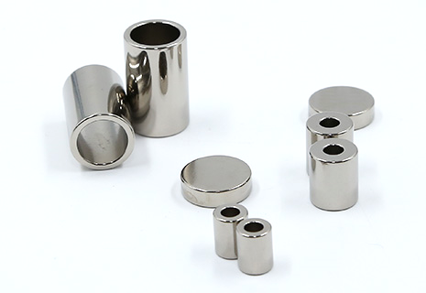
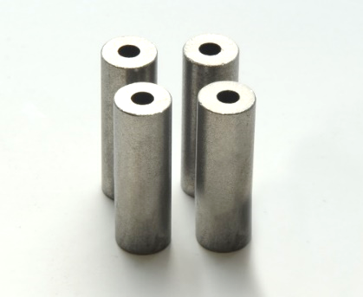




4. Balanced and cyclic utilization of rare earth resources in Earth-Panda
Sintered NdFeB permanent magnet (low heavy rare earth, high abundance rare earth, regenerated
rare earth permanent magnet)
Sintered Sm-Co permanent magnet (low temperature coefficient, high (BH)max)
Magnetic components (injection molding, adhesion)
Rubber magnet (ferrite, NdFeB)

Slide 36
4. Balanced and cyclic utilization of rare earth resources in Earth-Panda
Innovative work
Relying on national and provincial R&D platforms, the company has undertaken a total of 35 national and provincial level projects (including 23 projects related to waste magnet recycling and low/no heavy rare earth magnets).
Innovation achievements
The company has established a complete intellectual property system from the production of rare earth permanent magnet materials, product processing, surface protection, to regenerative manufacturing, and has multiple patented technologies (including European and American patents) on the balance and cyclic utilization of rare earth resources;
The company has published a total of 87 papers, applied 216 patents (including 102 invention patents), 198 authorized patents (including 63 invention patents), and formulated 14 national standards, 4 industry standards, and 2 group standards.
It has won 5 Anhui Provincial Science and Technology Progress Awards (including 2 first prizes) and 2 Ministry of Education Technology Invention Awards (including 1 first prize).
Material production
Product processing
Surface protection
Regenerative manufacturing
29 invention patents
25 utility model patents
6 national standards
3 invention patents
15 utility model patents
25 invention patents
6 utility model patents
2 national standards
5 invention patents, 1 national standards, 2 industry standards and 1 group standard

Slide 37
My speech is over. Thank you!
Comprehensively improving resource utilization efficiency and constructing a resource cyclic utilization system

